Slide 1


SABD - A.Y. 2023/24
Project 2: Real-time Analysis of Disk Monitoring Events with Apache Flink
Giulio Appetito
0321669

Slide 2

Introduction
Project Overview:
Analyzing telemetry data from ~200,000 hard disks managed by Backblaze.
Apache Flink for stream processing.
Dataset:
Derived from ACM DEBS 2024 Grand Challenge.
Contains ~3 million events.
Each event reports the S.M.A.R.T. status of a specific hard disk per day.
Outline:
System architecture
Dataset replay
Implementation of queries
Performance evaluation

Slide 3


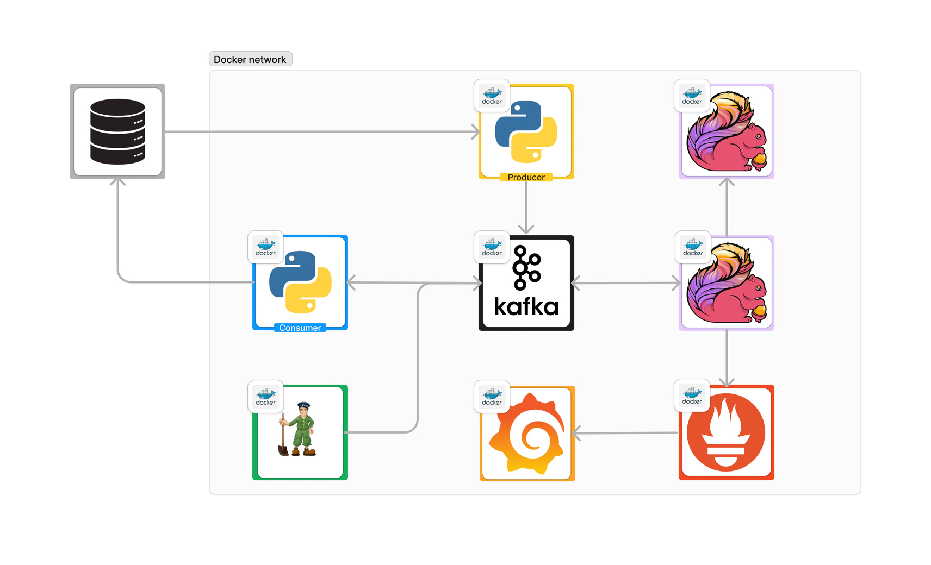
System architecture
Deployment:
Single node using Docker Compose
Bridge network for container communication
Key Design Decisions:
Kafka as intermediary for modularity and flexibility
Separate consumer node for better distribution of responsibilities
Flink configuration:
Parallelism : 1
Number of TaskManagers : 1
Number of JobManagers : 1
taskmanager.numberOfTaskSlots: 6
jobmanager.memory.process.size: 1024m
taskmanager.memory.process.size: 1024m

Slide 4

Dataset replay: Producer
Reading and Output:
Producer node written in Python reads dataset from local file
Outputs records in temporal order based on timestamps
Simulation:
Simulates the data flow by appropriately accelerating the time scale between the tuples, preserving consistency between time intervals.
Scaling factor variable is contained in the .env file, set to default to 3600 * 24.
Producer sleeps for a second between each day’s tuples.
Emits the tuples within a day in a single burst.
Since the dataset only reports the day of the events, the actual time between tuples within a day cannot be inferred.
A solution to this is optionally waiting for a randomized time between each tuple (between [0, 0.05]s).
Field Filtering:
Date, Serial number, Model, Failure, Vault ID, S9 power on hours, S194 temperature celsius
Data Processing:
Converts CSV rows to JSON with ad-hoc formats for fields
Publishes records to Kafka (hdd_events topic)
Outputs a final “dummy” record (timestamp: 2023-04-24T00:00:00.000000)

Slide 5

Query 1 - overview
Q1 Objectives:
For vaults with IDs between 1000 and 1020:
Calculate number of events
Compute average temperature (field: temperature_s194_Celsius)
Compute standard deviation of temperature
Time Windows:
1 day (event time)
3 days (event time)
From the beginning of the dataset (23 days)

Slide 6
Query 1 - schema
AggregateFunction
Process
Window
Function
Map to Row (date, vault_id, s194_temperature_celsius)
window
TumblingEventTimeWindows
Kafka Sink
Source
Timestamp and watermark
Filter
Map
Key_By
AggregateFunction
Process
Window
Function
Sink
Kafka Source
Assign Timestamps and Watermarks
Filter Vault IDs (1000-1020)
Key By vault_id
...
Process
Window
Function
AggregateFunction
Calculate Mean, Variance, Std Dev
Aggregate Temperature Stats

Slide 7
Query 1 - Steps(1-6)
1. Source:
KafkaConsumer reads tuples from hdd_events topic using Row_Named type in deserialization schema
2.Timestamp and Watermark:
Custom TimestampAssigner converts date to milliseconds.
Watermark strategy set as for_monotonous_timestamps().
3.Filter:
Retain records with vault ID between 1000 and 1020.
4.Map:
Select required fields:
Date
Vault ID
S194 temperature Celsius
5.Key By:
Key stream by vault_id.
6.Windows:
Apply TumblingEventTimeWindows:
1 day window
3 days window
23 days window (beginning of dataset)

Slide 8
Query 1 - Steps(7-9)
7.AggregateFunction:
Compute count, mean, and standard deviation in real-time using Welford algorithm:
Accumulator: (count, mean, M2)
update() Function: Updates count, mean, and M2 for new values.
get_result() Function: Returns the computed accumulator.
merge() Function: Merges two accumulators using Chan’s method.
8.ProcessWindowFunction:
Apply finalize() to compute standard deviation.
Compute square root of variance for standard deviation.
Add timestamp from the beginning of the window.
Return a Row: (ts, vault_id, count, mean, stddev).
9.Sink:
Route results to specific KafkaProducer for each window length.
Send results to respective Kafka topics for consumer reading.

Slide 9
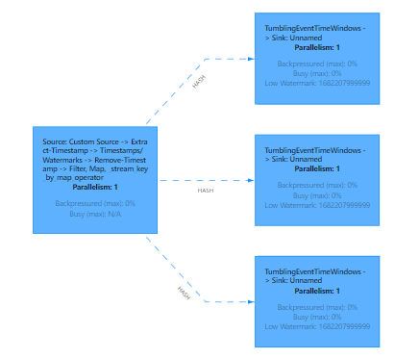
Query 1 - DAG

Slide 10
Query 2 - overview
Q2 Objectives:
Calculate real-time ranking of top 10 vaults with highest failures per day.
Report:
Timestamp
Number of failures per vault
Model and serial number of failed hard disks
Time Windows:
1 day (event time)
3 days (event time)
From the beginning of the dataset (23 days)

Slide 11
Query 2 - schema
ReduceFunction
window
TumblingEventTimeWindows
window_all TumblingEventTimeWindows
Aggregate Top 10 Vaults
Source
Timestamp and watermark
Filter
Map
Key_By
ReduceFunction
AggregateFunction
Kafka Source
Filter failures
Map to Tuple (vault_id, failures_count, failed_disks)
Key By vault_id
...
ReduceFunction
Kafka Sink
Convert to Row
Sink
Map
Reduce Failures Per Day
ProcessAllWindowFunction
Process Aggregated Results

Slide 12
Query 2 - Steps(1-5)
1.Source:
KafkaConsumer reads tuples from hdd_events topic, using Row_Named in deserialization schema
2.Timestamp and Watermark:
Custom TimestampAssigner converts date to milliseconds.
Watermark strategy set as for_monotonous_timestamps().
3.Filter:
Retain records with failure set to True.
4.Map:
Retain necessary fields:
Tuple: (vault_id, 1, [model, serial_number])
1 stands for a single failure.
5.Key By:
Key stream by vault_id.

Slide 13
Query 2 - Steps(5-8)
6.Window:
Apply TumblingEventTimeWindows of 1 day.
7.ReduceFunction:
Apply VaultFailuresPerDayReduceFunction:
Receives two tuples.
Sums failure counts.
Concatenates lists of failed disks.
Returns tuple: (vault_id, failure_count, failed_disks).
8.Window:
Apply TumblingEventTimeWindows of 1, 3, and 23 days by means of window_all method

Slide 14
Query 2 - Steps(9-12)
9.AggregateFunction:
FailuresAggregateFunction:
Accumulator: List of vaults, their failure counts and failed disks.
add() Function:
Updates existing vault entry if new failure count is higher.
Adds new entry if vault not already in accumulator.
Sorts accumulator by failure count.
Returns top 10 entries.
merge() Function:
Combines two accumulators.
Keeps entry with maximum failure count for each vault.
Converts dictionary back to list.
Sorts list and returns top 10 entries.
get_result() Function:
Returns the ranking accumulator.
10. ProcessAllWindowFunction:
Applies timestamp from beginning of window.
Returns tuple: (window.start, ranking).
11.Map:
Converts tuples to rows for serialization schema compliance.
12.Sink:
Routes results to specific KafkaProducer for each window length.
Sends results to respective Kafka topics for consumer reading.

Slide 15
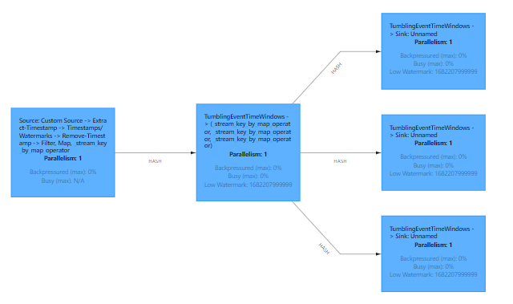
Query 2 - DAG

Slide 16
Results
Simulation setup
Environment:
Docker Compose on a single node
Apache Flink Configuration:
Parallelism : 1
Number of TaskManagers : 1
Number of JobManagers : 1
taskmanager.numberOfTaskSlots: 6
jobmanager.memory.process.size: 1024m
taskmanager.memory.process.size: 1024m
HW Specifications:
CPU: 13th Gen Intel(R) Core(TM) i7-13700H, 2400 MHz, 14 cores, 20 logical processors
RAM: 16GB

Slide 17
Results
Evaluation metrics
Metrics:
Throughput
Latency
Job Configurations:
Three distinct jobs with time windows of 1 day, 3 days, and 23 days executed by means of env.execute_async()
Producer Node produces tuples in a burst within one day
Latency Tracking:
Activated in Flink: env.get_config().set_latency_tracking_interval(10)

Slide 18
Results
Latency Measurement
Objective:
Evaluate the impact of time window size on latency
Methodology:
Metric Used:
flink_taskmanager_job_latency_source_id_operator_id_operator_subtask_index_latency
records the latency at the level of individual operators and subtasks within the Flink jobs, given a source id and an operator id
Data Collection: Prometheus
Data Visualization: Grafana
Aggregation: Maximum latency over job.name dimension, 0.999 quantile

Slide 19
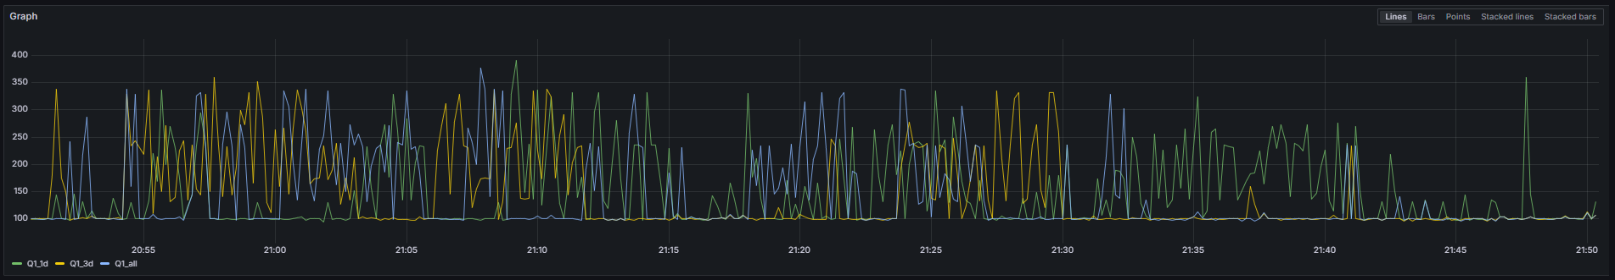
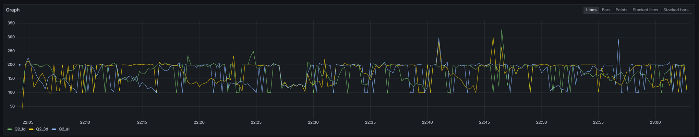
Observations:
Larger time windows tend to have lower latency
Reason: Larger windows require more tuples accumulation before processing, reducing queueing time
Latency Tracking Insights:
Markers: Bypass user functions, measure travel time
Latency Trends:
Jobs with global and 3-day windows show lower latency than daily windows
Latency Spikes:
Cause: Resource contention and high computational load
Results
Latency Results
Q1 Job
Q2 Job

Slide 20
Results
Throughput Measurement
Objective:
Assess the impact of time window size on throughput
Methodology:
Metric Used:
flink_taskmanager_job_task_operator_numRecordsOutPerSecond
Data Collection: Prometheus
Data Visualization: Grafana
Aggregation: Average throughput per job.name

Slide 21
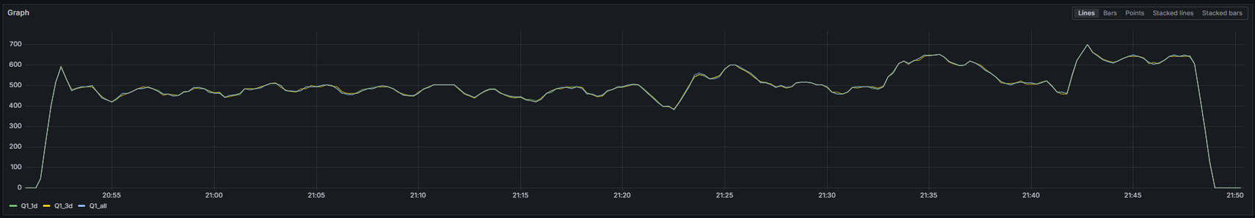
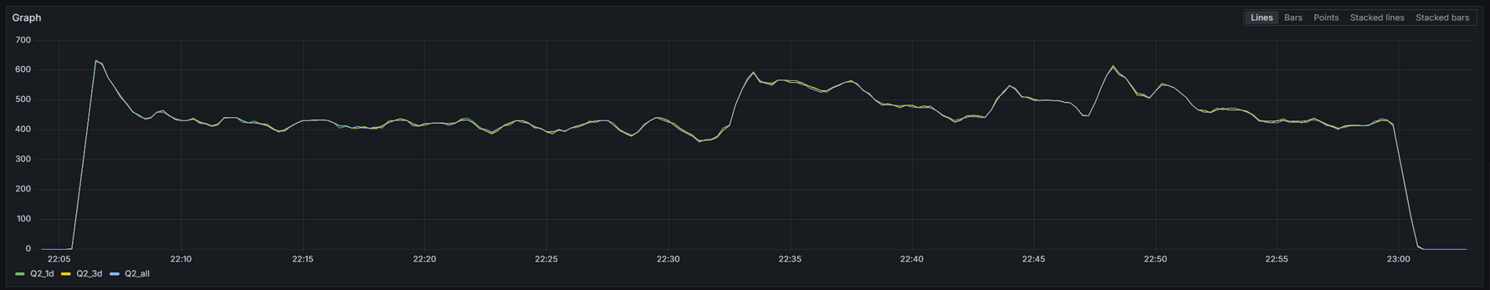
Observations:
Similar throughput trends for all window configurations (1 day, 3 days, 23 days)
Steady State: ~500 records/second after initial ramp-up
Job Specifics:
Q1: Throughput stabilizes around 500 records/second
Q2: Slightly lower steady state value due to increased operator complexity
Window Size Impact:
Minimal effect on throughput
Reason: Metric focuses on individual operator processing rate
Throughput Spikes:
Cause: Resource contention and high computational load
Results
Throughput Results
Q1 Job
Q2 Job

Slide 22


Thank you for listening!
Giulio Appetito
0321669
giulio.appetito@alumni.uniroma2.eu
https://github.com/GiulioAppetito

